Slide 1
Narrative Algorithm Study

Slide 2
Rules for a Story:
Click here to hear Cinderella
Titles
Characters
Theme/Heart/Message
Sequence: Beginning, Middle, End
Problem
Solution
Pictures
Writing
Illustrator
Genre
Passage/Paragraphs
Author
Different words
Setting
Initiums
Quotation Marks
Correct spelling
Similes
Actions
Happy ending
Notes:
Have students list what they know about stories

Slide 3
Rules for a Story: Click here to hear Cinderella
Characters’ names
Main Idea
Climax
Different language
Lesson
Notes:
The list continues

Slide 4

Algorithm for writing a story
THINK: WHAT ARE THE REQUIREMENTS FOR STORY?
Get rid of ideas that are not required.

Slide 5
Rules for a Story:
Click here to hear Cinderella
Titles
Characters
Theme/Heart/Message
Sequence: Beginning, Middle, End
Problem
Solution
Pictures
Writing
Illustrator
Genre
Passage/Paragraphs
Author
Different words
Setting
Initiums
Quotation Marks
Correct spelling
Similes
Actions
Happy ending
Notes:
Students remove “rules” that are not absolutely necessary for a story

Slide 6
Rules for a Story: Click here to hear Cinderella
Characters’ names
Main Idea
Climax
Different language
Lesson
Notes:
Continue removing ideas from the list

Slide 7
Algorithm for writing a story
THINK: WHAT ARE THE REQUIREMENTS FOR STORY?
Titles
Characters
Sequence: Beginning, Middle, End
Problem
Solution
Author
Different words
Setting
Quotation Marks
Correct spelling
Genre
Characters’ names
Main Idea
Climax
Writing
Notes:
List remaining “rules.”

Slide 8
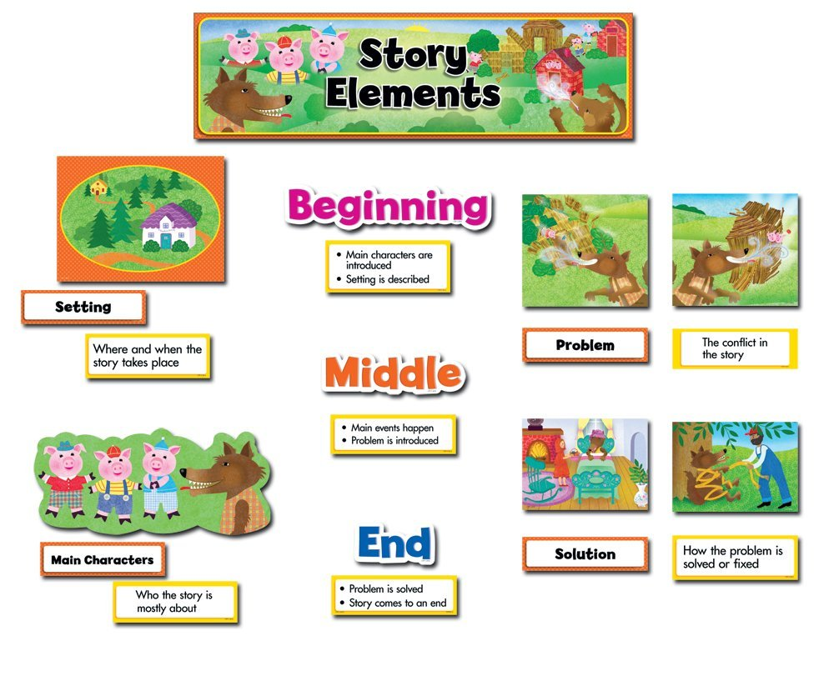
Notes:
All stories must contain story elements.

Slide 9
Algorithm Checklist
Notes:
Create the checklist based on slide 7 or 8.

Slide 10
Narrative Example: The Barn Cat
“We should get a barn cat,” Mrs. Thurlow told Mr. Thurlow. Bandit, Sonya, and Sam’s ears popped up. Bandit, Sonya, and Sam were their barn dogs. “Yes! A cat to chase!” Bandit yelled. Then Mr. Thurlow said, “Sure, but what are we going to name her?” Sam thought for a moment. Then Sam walked up to Mr. Thurlow and started to bark. Bandit and Sonya heard Sam say, “Whatever you do, don’t name her Samantha, don’t name her Samantha, DON’T name her Samantha!” Mrs. Thurlow said, “How about ‘Baby’?” Mr. and Mrs. Thurlow thought for a while. After much thought, Mr. Thurlow announced, “A splendid idea! Let’s get her tomorrow!” Then the two farmers fed the dogs, ate dinner, did the chores, and then went to bed.
Notes:
Use the checklist to determine if this story follows the algorithm.

Slide 11
Narrative Example: The Barn Cat
The next morning at 6:00, they did the morning chores. They were ready to pick up Baby at 8:15 a.m. When they got to The Pet Shop in Woodstock, they were in and out. Mr. and Mrs. Thurlow gave Baby a collar when they got home. Also Bandit, Sonya, and Sam gave Baby a tour of everything they own. When they got to the barn, Bandit started to chase Baby, and he said, "I can't resist!" Sam and Sonya tried to stop Bandit, but Bandit was too fast! Baby ran to the barn across the street. “We’re not supposed to be here!” Sam and Sonya yelled to Baby, so she ran back home, and the 31 dogs followed. Baby jumped up on a footrest and then calmed down. Bandit agreed to never chase Baby again.

Slide 12
Off-Task Story: The Haunted House
There once was a dog that roamed an alley with another dog. That dog’s name was Max. The other dog’s name was Rocky. Max and Rocky were brother and sister, although they looked nothing alike. In another alley, not far from Max and Rocky’s, there was a dog and a cat that lived together. The dog’s name was Sugar, and the cat’s name was Shantell. One day, they all met behind a trash can and became best buds. One day while all the friends were out walking in the street, Shantell spotted a ghost flying around in a house and took off running to go see the ghost. Then all the dogs took off after her.
Notes:
http://www.salemnj.org/UserFiles/Servers/Server_5607714/File/Curriculum/K-12%20Common%20Core%20Writing%20Samples-Narrative.pdf
Use the checklist to determine if this story follows the algorithm. Students discuss what happens when the algorithm is not followed. What went wrong? How would they fix it?

Slide 13
Off-Task Story
When the dogs finally caught up to Shantell, they heard a loud “boom” came from the floor above them. After, Max got a brilliant idea: they should sneak up on the monsters and attack them.
The music sounded a lot like this: “Shake, shake, shake dem bones 36 now!” The friends were confused but quickly got back on track. Shantell gave the ready signal, and they all jumped up. They were surprised to see what they saw. One of the vampires said, "Come in, dogs and cats. Why don’t you dance with us?” So Max, Rocky, Sugar, and Shantell

Slide 14
Debugging: What errors should I look for?
THINK: WHAT DO I READ FOR WHEN I FIX MY WRITING?
Missing parts
Sentence structure
Details
Setting
Sequence
Repeating words
Check new ideas that don’t match
Notes:
Students list ways they fix their writing.

Slide 15
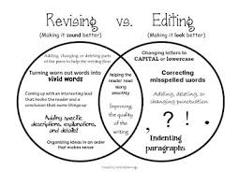
Debugging: What errors should I look for?
THINK: WHAT DO I READ FOR WHEN I FIX MY WRITING?

Slide 16
Hour of Code
RIGHT
UP
LEFT
DOWN
Notes:
Choose a culminating activity that supports the unit. Koding Kurriculum can help!

